Slide 1
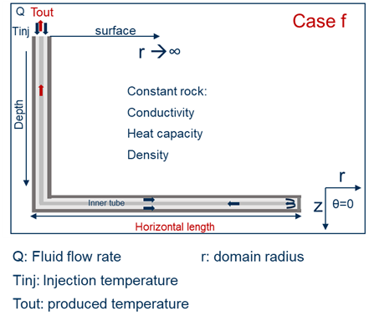
Task 2.2-2.3: Modified Nusselt number
Based on the preliminary results of Nitish (VITO) for eccentricity
Case F of Task 2.1/2.2
Fix Nusselt number in the annulus side
Nu_{max} = 262 (fully concentric pipes)
Nu_{min} = 70 (eccentric pipes)
Time: t_{min} – 10 years
Report:
Temporal evolution (for all time steps) of outlet pressure, temperature, enthalpy difference, power (P, T, ΔH, Q vs. t)
Case | Nu
1 | 262
2 | 230
3 | 190
4 | 150
5 | 110
6 | 70
Injection |  |  | Geometry |  | Tubing |  |  | Casing |  | Rocks
Flow rate Q [kg/s] | Temperature T [°C] | Pressure P [bar] | Depth D [km] | Length L [km] | Diameter d [mm] |  | Conductivity k_{i} [W/m/K] | Diameter d [mm] |  | Gradient g_{T} [°C/km] | Conductivity k_{r} [W/m/K] | Capacity Cp_{r} [J/kg/K] | Density ρ_{r} [kg/m³]
 |  |  |  |  | OD | ID
 |  |  |  |  |  |  |  | OD | ID
8.8 | 45 | 40 | 3 | 3.5 | 0.05 | 0.08 | 0.1 | 0.1778 | 0.1617 | 32.5 | 2.423 | 902.67 | 2600

